Slide 1
The effects of noise on quantum algorithms solving 3-SAT
By: Martijn Swenne
Supervised by: Vedran Dunjko
Notes:
Hello everyone,
I am Martijn Swenne and today I am going to tell you some things about my bachelor thesis, which is about"The effects of noise on quantum algorithms solving 3-SAT" and is supervised by Vedran Dunjko.

Slide 2
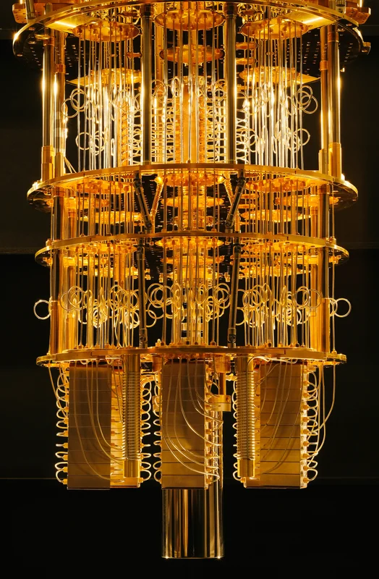
Real Quantum Computers
Very small
few amount qubits
Very noisy
fault-tolerant quantum computing not
yet possible
Notes:
Current Quantum computers are very small and they usually don't have many qubits you can work with. They are also very noisy, which is currently a very big problem in quantum computing. It is not yet possible to do fault-tolerant quantum computing, which is why researching the effects of noise will be very interesting and rewarding. I am researching noise on algorithms solving 3-SAT because SAT problems are difficult to solve, and quantum computing can help make it faster.

Slide 3

Quantum Registers
Two states of a qubit denoted by ∣0〉and ∣1〉.
Superposition of the two states denote by α∣0〉+β∣1〉
where α and β are complex numbers and |α|² + |β|²=1
Represented in matrix notation:
Notes:
Let me first start with some of the basics of quantum computing. Here we do not work with classical bits, but with quantum bits, or qubits. Just as in classical bits, the qubits have a state 0 and a state 1, which are represented as such {point to slide}. But the special thing about qubits is that they don't have to be one or the other, they can be in two states at the same time. Such a state, being neither 0 or 1, is called a superposition.
A superposition of the two states is written like this {point to slide}. When we measure a qubit in such a superposition state, the state falls back into a classical state of 0 or 1, depending on the superposition. The chances of the qubit falling into state 0 is the absolute value of alpha, squared, and the chances of the qubit falling into state 1 is the absolute value of beta, squared. These chances should always sum up to a probability of 100%.
These values are usually represented in a vector form like this {point to slide}. Since with 2 qubits, we have 4 different possibilities, namely 00, 01, 10 and 11, our vector will have a dimension of 4, with each value corresponding to a state. This grows exponentially, as the matrix dimension is the amount of qubits squared.

Slide 4
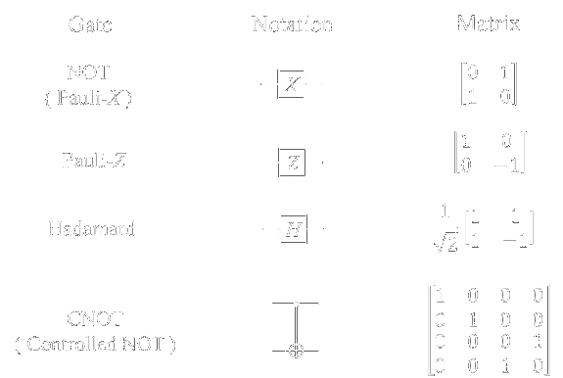
Quantum Circuits
Made out of quantum gates
Gates must be reversible
Some basic gates:
Notes:
Quantum computing is done by making a quantum circuit, built out of quantum gates. Quantum gates are similar to classical gates, but their original input state can be derived from their output state, uniquely. For instance, after a classical AND gate, you have no way of knowing what the input was if the output is a 0.
The simplest quantum gate involves one qubit and is called a Hadamard Gate, which is used to put qubits into a superposition state. Then we have the Pauli gates. The Pauli X gate, which is basically a NOT gate, flips the values of the qubit vector, and the Pauli-Z is a rotation gate, which applies a one pi rotation on the qubit vector. An important gate which operates on two qubits is called a Controlled-NOT gate. If the qubit on the control line is 1, it inverts the qubit on the target line.
All gates are represented by matrices. This means that you can calculate the output of a gate by multiplying the vector of the input qubit with the matrix of the gate.
So, how do you implement this? Well, there is Qiskit….

Slide 5
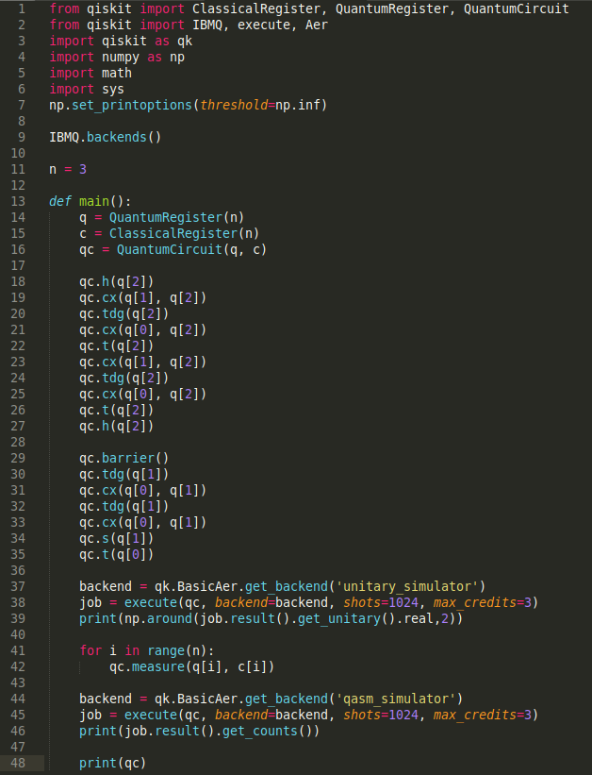
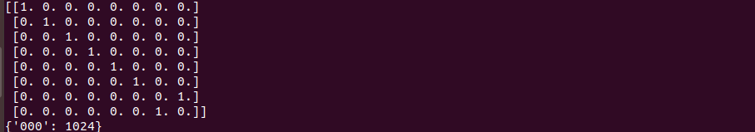
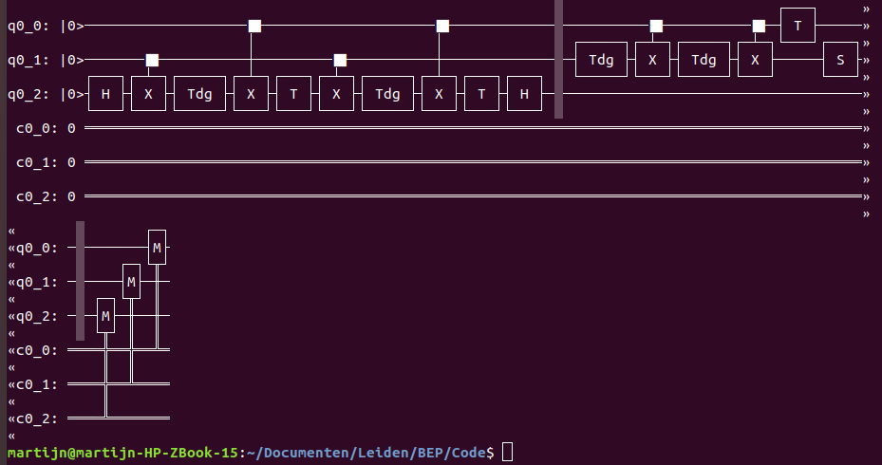
Coding with Qiskit
An open-source quantum computing framework for Python
Simulate or run quantum circuits on IBM backend
Notes:
Qiskit is an open-source quantum computing framework for python, but they have also a version for Java. With qiskit you can run your quantum circuit on a real quantum computer of IBM, or simulate the results on one of IBM's backend simulators.
Coding with Qiskit looks something like this. On the right {point at image} you can see a very simple python script, which implements an runs a quantum circuit. First we import the basics of the qiskit. After that we call the backends from IBMQ. Now we start building the circuit. First we define the registers for both the qubits and classical bits and then we make a quantum circuit with these registers.
After that we put in some basic gates, such as the hadamard gate {point} or the controlled not {point}. You need to define which qubits they work on as such {point at gate}. Now the circuit is done. If we want to see the matrix that represents this circuit, we can call the unitary_simulator backend an run it. Then if we print the results we see the unitary matrix {point}. If we want to see the result of the executed gate, we first need to measure the qubits after the gate. The results will be stored in the classical register. Then we call the qasm_simulator backend and run that. If we print the result, we see that there is a 100% chance all our qubits are zero. If we want to see the circuit, calling print on our circuit {point} will print the circuit like this {point at circuit}.

Slide 6
3-SAT
Boolean satisfiability
Conjunctive Normal Form
Find x where f(x) = true
Brute force: 2^{n} → Best algorithm: 2^{0.41n}
Notes:
I assume most of you know what 3-SAT is, so a quick a refreshment on your memories. 3-SAT a boolean satisfiability problem. It's boolean formula is in conjunctive normal form, or CNF. A 3-SAT formula looks like this {point}, where each literal is a variable, or the negation of that variable. Solving a boolean formula means finding a representation of x, where each variable is set to true or false and the boolean formula yields true.
3-SAT is a very difficult problem. The best algorithms for SAT are not much better than brute force, namely not 2 to the power n, but 2 to the power of 0.41n. This is why Quantum SAT solving will have a big impact in SAT solving.

Slide 7

Grover's search
brute force
2^{n} -> 2^{0.5n}
Given a quantum implementation of a formula, it can find the satisfying assignment, if one exists
Is there a few qubit circuit solving boolean formulas?
Does it still work with noise?
Notes:
The most common quantum algorithm to solve a boolean formula is Grover’s search. It is a brute force search, but since it is a quantum algorithm, it only uses O(2^0.5n) evaluations instead of the classical O(2^n) evaluations. Given a black box function which represents the quantum implementation of the formula you want to solve, the algorithm can find a unique input that is a satisfying solution for the boolean formula, if such an unique input exists. But since we don't have many qubits to work with, we need an implementation of this algorithm, such that it needs as few qubits as possible. And even more important, does the algorithm even work when noise is applied?

Slide 8
Quantum formula evaluation
Keep track of the result of each clause
qubits used as extra workspace are called ancillas
M clauses → M ancillas
Controlled incrementer → log(M) ancillas
Notes:
For 3-SAT it the algorithm needs to store the results of every clause. So for every clause you need an extra workspace qubit to store this, or a so called ancilla. For let’s say M clauses, we would need M ancillas. Now there is a way that needs less ancillas. I implemented an incrementer, which takes the input value an adds 1. Now the amount of clauses, the value M, can be represented in binary by at most log(M) ancillas. We simply use a controlled incrementer on the ancillas for each clause and check if the ancillas represent the number M. This is already a big reduction, but the amount of ancillas can be reduced even more.

Slide 9


Towards space efficient quantum SAT solving
Fixed point amplitude amplification (FPAA)
by Theodore J. Yoder, Guang Hao Low, Isaac L. Chuang
rotate ancilla for every clause that yields false
Amplify the rotation to 1
FPAA → 2 ancillas
Most space-efficient algorithm for formula evaluation!
Notes:
There is a paper by Yoder, Low and Chuang, which altered Grover’s search in such a way that it amplifies a rotation from an initial state to a target state. This is called fixed point amplitude amplification, or FPAA. We use this in the general Grover’s search. For every clause, if it is NOT satisfied, we rotate 1 ancilla by a certain rotation. So if all clauses are satisfied, this ancilla is 0, and if one or more clauses are not satisfied, the it will have a certain rotation bigger than zero. Then we use the FPAA with this rotation as initial state and 1 as target state, which only uses 1 ancilla. After the FPAA the unique input will be 0 and the rest will be 1. The rest of Grover’s search can be done the same as before. We now reduced the amount of ancillas to 2. This is so far the most space efficient algorithm for formula evaluation and a key step in Quantum SAT solving, which also uses genuine quantum effects and is not just a reversible implementation of a classical algorithm!

Slide 10
Progress and future work
Implemented multiple-controlled-NOT gate without ancillas
Implemented basic Grover’s search for 3-SAT
Implemented improvements (M → log(M) → 2 ancillas)
Will implement k-SAT Grover’s search
Will implement basic noise problems on Grover’s search
Notes:
To summarize: at first I implemented a multiple-controlled-NOT gate. While normally you use ancillas to implement this, I used rotation gates, which eliminated the ancillas all together. Secondly I implemented a very basic Grover’s search and extended it to work on 3-SAT. And at last I implemented some improvements for Grover’s search, which reduces the amount of ancillas from M to just 2 ancillas!
The coming weeks I will extend my implementation of Grover’s search to work on k-SAT. This is very interesting, because even though Grover’s search is not faster than the best classical algorithm solving 3-SAT, it WILL be faster on every k-SAT bigger than some specific value of k. And eventually I will implement some amount of noise in my implementation to test how noise will affect the result of the algorithm.

Slide 11
An introduction to quantum computing;
Noson S. Yanofsky
Fixed-point quantum search with an optimal number of queries;
Theodore J. Yoder, Guang Hao Low, Isaac L. Chuang
Computational speedups using small quantum devices;
Vedran Dunjko, Yimin Ge, and J. Ignacio Cirac
Notes:
This was my presentation, are there any questions?

